Slide 1
What is Dom

Slide 2
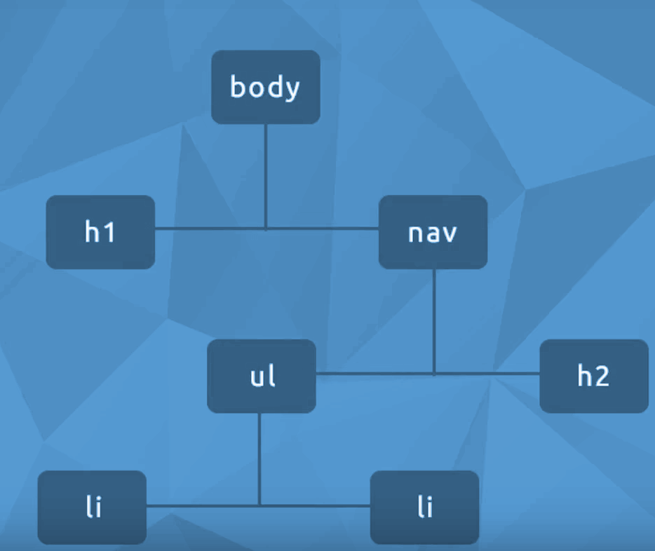
Document Object Model
Created by the browser when a
Web page is loaded
In graphical form, it looks like a tree of elements / nodes
Programatically, we can use JS to read and change the DOM

Slide 3
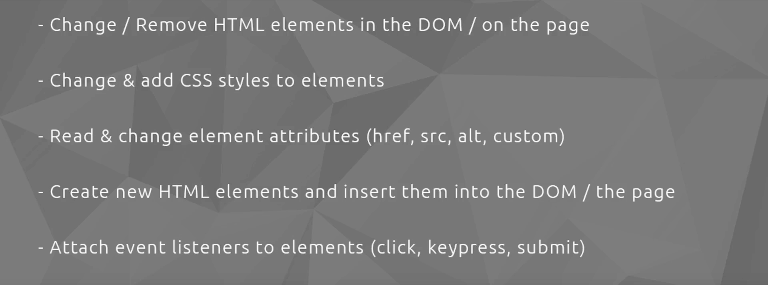

Slide 4
Get a Element By Id()
Get Element By Class Or Tag()
querySelector()
Change Text content
Events()
Event Bubbling()
Creating Elements()
Removing Elements

